Slide 1
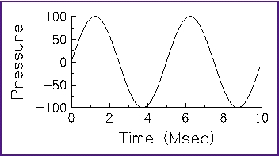
Time Domain and Frequency Domain
Time Domain:
Tells us how properties (air pressure in a sound function, for example) change over time:
Amplitude = 100
Frequency = number of cycles in one second = 200 Hz

Slide 2
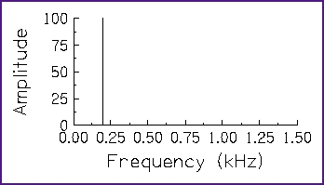
Time Domain and Frequency Domain
Frequency domain:
Tells us how properties (amplitudes) change over frequencies:

Slide 3
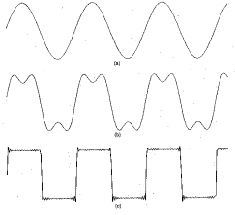
Time Domain and Frequency Domain
In 1807, Jean Baptiste Joseph Fourier showed that any periodic signal could be represented by a series of sinusoidal functions
In picture: the composition of the first two functions gives the bottom one

Slide 4
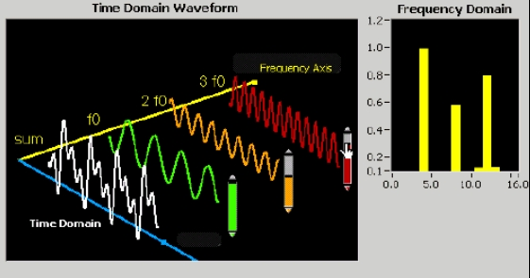
Time Domain and Frequency Domain

Slide 5
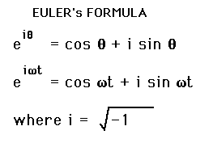
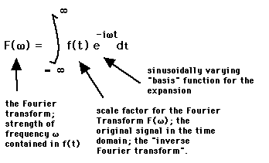
Fourier Transform
Because of the
property:
Fourier Transform takes us to the frequency domain:
Notes:
The property of euler number is what gives the F transform the power to take us to freq. domain

Slide 6
Discrete Fourier Transform
In practice, we often deal with discrete functions (digital signals, for example)
Discrete version of the Fourier Transform is much more useful in computer science:
O(n²) time complexity

Slide 7
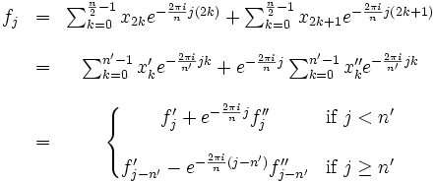
Fast Fourier Transform
Many techniques introduced that reduce computing time to O(n log n)
Most popular one: radix-2 decimation-in-time (DIT) FFT Cooley-Tukey algorithm:
(Divide and conquer)

Slide 8
Summary
Transforms:
Useful in mathematics (solving DE)
Fourier Transform:
Lets us easily switch between time-space domain and frequency domain so applicable in many other areas
Easy to pick out frequencies
Many applications

Slide 9
References
Concepts and the frequency domain
http://www.spd.eee.strath.ac.uk/~interact/fourier/concepts.html
THE FREQUENCY DOMAIN Introduction
http://www.netnam.vn/unescocourse/computervision/91.htm
JPNM Physics Fourier Transform
http://www.med.harvard.edu/JPNM/physics/didactics/improc/intro/fourier2.html
Introduction to the Frequency Domain
http://zone.ni.com/devzone/conceptd.nsf/webmain/F814BEB1A040CDC68625684600508C88
Fourier Transform Filtering Techniques
http://www.olympusmicro.com/primer/java/digitalimaging/processing/fouriertransform/index.html
Fourier Transform (Efunda)
http://www.efunda.com/math/fourier_transform/
Integral Transforms
http://www.britannica.com/ebc/article?tocId=9368037&query=transform&ct=

